Slide 1
Welcome
to
Better
Tuition

Slide 2
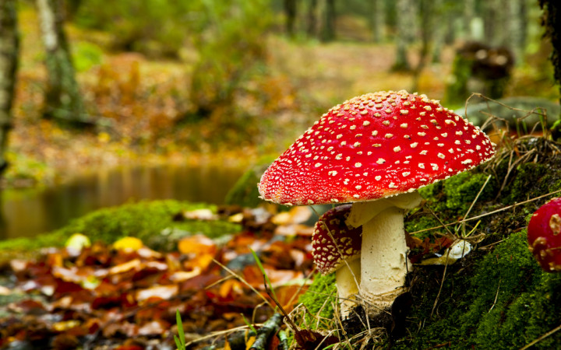
How many
words can you make using
the letters
t i n t i e
t u r b o t e
?
Send your answers in chat.

Slide 3
CATEGORY OF THE WEEK
2-minute challenge
1) What do all these words have in common?
azure n emerald n alabaster n cerise n coral n crimson n ebony n
Send your answers in chat.
2) How many items can you add to this category?

Slide 4
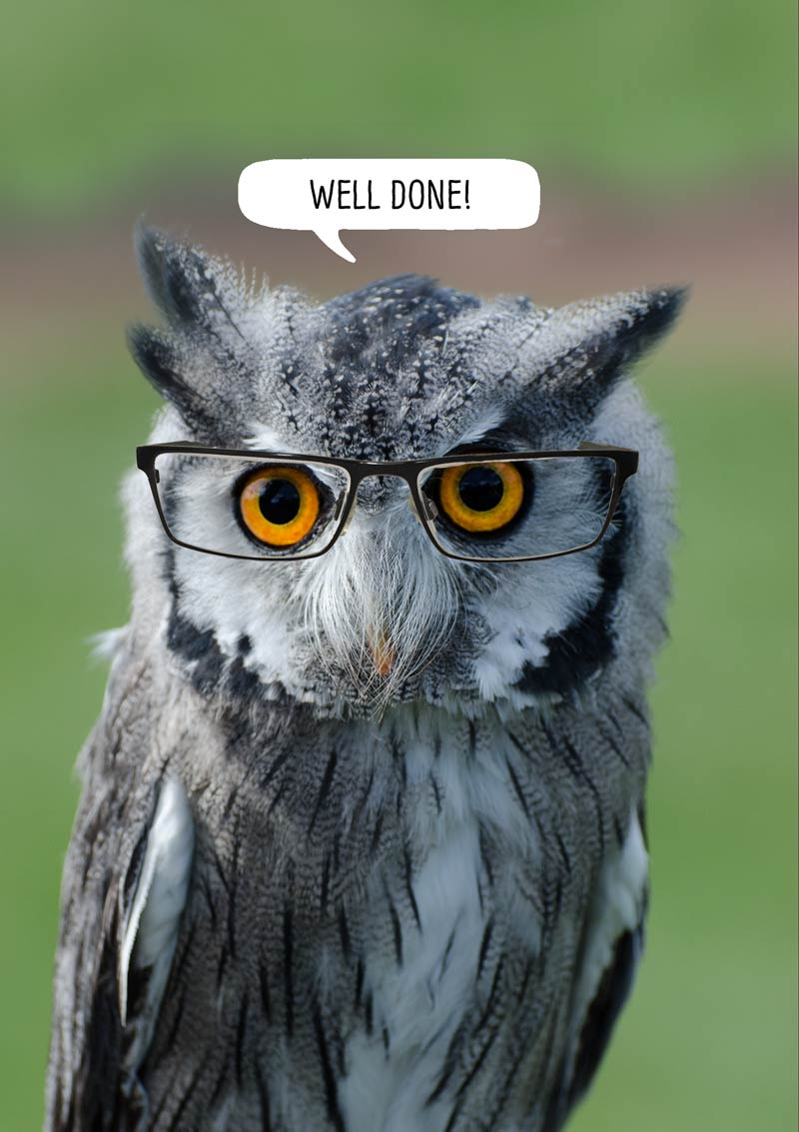
VOCABULARY TEST
RIGID
DEVIOUS
VOLATILE
PROSPEROUS
Write: Vocabulary Test 1) 2)
3)
4)
5)
6)
SOBER
APPREHENSIVE
UNSURPASSED
GROTESQUE
TEMPESTUOUS
FEEBLE
SUPERFLUOUS
CONSPICUOUS
VENERABLE
CHARRED
ROBUST
MEAGRE
WRETCHED
WHOLESOME

Slide 5
Reverse Cloze
An ever-popular pastime, baking is fun but preparation can be complex. Firstly, it’s important to assemble the correct ingredients and ensure you have the proper equipment ready. You don’t need expensive gadgets but a large bowl, a mixing spoon, a set of scales and an oven are crucial. You must weigh your ingredients with exact precision, then mix them together. The principal mixing methods you should know are blending, beating, creaming, folding, stirring, sifting and whipping. Make sure you bake your creation at the correct temperature, checking it frequently to avoid ending up with a charred mess.
Write: Reverse Cloze 1) 2)
3)
4)
5)
6)
Cover up the bottom of the screen if you don’t want help.
Choose from: accuracy main blackened essential elaborate collate

Slide 6
Reverse Cloze
An ever-popular pastime, baking is fun but preparation can be complex/ELABORATE. Firstly, it’s important to assemble/ COLLATE the correct ingredients and ensure you have the proper equipment ready. You don’t need expensive gadgets but a large bowl, a mixing spoon, a set of scales and an oven are crucial/ESSENTIAL. You must weigh your ingredients with exact precision/ACCURACY, then mix them together. The principal/MAIN mixing methods you should know are blending, beating, creaming, folding, stirring, sifting and whipping. Make sure you bake your creation at the correct temperature, checking it frequently to avoid ending up with a charred/ BLACKENED mess.
Cover up the bottom of the screen if you don’t want help.
Choose from: accuracy main blackened essential elaborate collate

Slide 7
2-FOR-1 Words
EACH OF THESE WORDS HAS TWO MEANINGS
READ AND MEMORISE
WORD | MEANING (NOUN) | MEANING (VERB)
address | Number, street and town where someone lives | Speak to
compound | An area of land with a fence around it that is used for something | Make something worse
consort | The wife or husband of a king or queen | To spend time (with)
desert | An area of land that has no water or plants | To leave something or some place on its own
entrance | The way in | Make someone feel that you are wonderful so that they cannot think of anything else
gorge | Valley with steep sides made of rock | Eat lots of something in a greedy way
import | The importance of something | Bring something into the country from abroad
suspect | Someone who the police think may be involved in a crime | To believe that something might be true

Slide 8
2-FOR-1 Words
Use one word for two gaps
1a) After sailing I always on chips on the seafront. b) He broke his leg after falling down a deep .
Write: 2-For-1 Gapfill 1) 2)
3)
4)
5)
6)
7)
8)
2a) Taking a deep breath, she began to the mob. b) Hana carefully wrote the on the envelope.
3a) Not doing your homework will only your problems. b) The soldiers were based in a military .
4a) In the United Kingdom, we most of our avocados from Europe. b) The teacher smiled and said that a mistake or two was of no .
2 mins
CHOOSE FROM: import compound address gorge

Slide 9
2-FOR-1 Words
Use one word for two gaps
5a) Archie liked to with other boys who liked football. b) The Queen’s was Prince Philip.
6a) I couldn’t help but that she had copied her neighbour. b) The police made him a in the murder case.
7a) Cinderella’s pretty eyes never failed to everyone in the kingdom. b) The palace was reached by a long, sweeping path.
8) She decided to her friend without a second thought. b) For three days, they traipsed over the hot sand.
2 mins
CHOOSE FROM: suspect desert consort entrance

Slide 10
2-FOR-1 Words
A N S W E R s
1a) After sailing I always GORGE on chips on the seafront. b) He broke his leg after falling down a deep GORGE.
2a) Taking a deep breath, she began to ADDRESS the mob. b) Hana carefully wrote the ADDRESS on the envelope.
3a) Not doing your homework will only COMPOUND your problems. b) The soldiers were based in a military COMPOUND.
4a) In the United Kingdom, we IMPORT most of our avocados from Europe. b) The teacher smiled and said that a mistake or two was of no IMPORT .
2 mins
CHOOSE FROM: import compound address gorge

Slide 11
2-FOR-1 Words
Use one word for two gaps
5a) Archie liked to CONSORT with other boys who liked football. b) The Queen’s CONSORT was Prince Philip.
6a) I couldn’t help but SUSPECT that she had copied her neighbour. b) The police made him a SUSPECT in the murder case.
7a) Cinderella’s pretty eyes never failed to ENTRANCE everyone in the kingdom. b) The palace ENTRANCE was reached by a long, sweeping path.
8) She decided to DESERT her friend without a second thought. b) For three days, they traipsed over the hot DESERT sand.
2 mins
CHOOSE FROM: suspect desert consort entrance

Slide 12
ANTONYMS 2
desert
Write: Synonyms & Antonyms 1) 2)
3)
4)
5)
6)
7)
8)
9)
10)
know
improve
fast
ignore
avoid
export
entrance
accompany
suspect
disgust
compound
consort
import
address
gorge

Slide 13
ANTONYMS 2
desert
suspect
know
improve
fast
ignore
avoid
export
entrance
accompany
disgust
compound
consort
import
address
gorge

Slide 14
ANTONYMS 2
desert
suspect
know
improve
fast
ignore
avoid
export
entrance
accompany
compound
disgust
consort
import
address
gorge

Slide 15
ANTONYMS 2
desert
suspect
know
improve
fast
ignore
avoid
export
entrance
accompany
compound
gorge
disgust
consort
import
address

Slide 16
ANTONYMS 2
desert
suspect
know
improve
fast
ignore
avoid
export
entrance
accompany
compound
gorge
disgust
address
consort
import

Slide 17
ANTONYMS 2
desert
suspect
know
improve
fast
ignore
avoid
export
entrance
accompany
compound
gorge
disgust
address
consort
import

Slide 18
ANTONYMS 2
desert
suspect
know
improve
fast
ignore
avoid
export
entrance
accompany
compound
gorge
disgust
address
consort
import

Slide 19
ANTONYMS 2
desert
suspect
know
improve
fast
ignore
avoid
export
entrance
accompany
compound
gorge
address
consort
import
disgust

Slide 20
ANTONYMS 2
suspect
know
improve
fast
ignore
avoid
export
entrance
accompany
compound
gorge
address
consort
import
disgust
desert

Slide 21
Prefixes
UN
IM
DIS
OPPOSITE-MAKERS
IL
UNTIDY, IMPOSSIBLE, INACTIVE, DISAPPROVE
RE
REPLAY, REVERSE, REVIEW
AGAIN
EN
ENTRUST, ENCODE, ENCOURAGE
PUT IN
PREVIEW, PREFIX, PREPAY
PRE
BEFORE
POST
POSTMATCH, POSTWAR
AFTER

Slide 22
SUFfixes
TION
SION
NOUN-MAKERS
ANCE
ACTION, CONFUSION, PERFORMANCE, DIFFERENCE
ENCE
MENT
FUL
ABLE
ADJECTIVE-MAKERS
IBLE
BEAUTIFUL, RELIABLE, CONVERTIBLE
LY
ADVERB-MAKER
KINDLY, QUICKLY, RUDELY

Slide 23
SUCCESS
1
RESPECT
2
MENT
Write: Prefixes and Suffixes Quiz 1) 2)
3)
4)
5)
6)
7)
8) 9) 10)
IM
ARRANGE
SION
3
COURAGE
ANCE
DIS
4
PASS
ENCE
UN
5
MEASURE
TION
IL
6
LOYAL
7
IBLE
RE
LEGAL
8
FUL
EN
APPEAR
9
ABLE
PRE
DIGEST
10
POST
LY

Slide 24
UN
FUL
SUCCESS
1
RESPECT
2
MENT
IM
ARRANGE
SION
3
COURAGE
ANCE
4
PASS
ENCE
DIS
5
MEASURE
TION
IL
6
LOYAL
7
IBLE
RE
LEGAL
8
EN
APPEAR
9
ABLE
PRE
DIGEST
10
POST
LY

Slide 25
UN
FUL
SUCCESS
1
DIS
FUL
RESPECT
2
MENT
IM
ARRANGE
SION
3
COURAGE
ANCE
4
PASS
ENCE
5
MEASURE
TION
IL
6
LOYAL
7
IBLE
RE
LEGAL
8
EN
APPEAR
9
ABLE
PRE
DIGEST
10
POST
LY

Slide 26
UN
FUL
SUCCESS
1
DIS
FUL
RESPECT
2
RE
MENT
ARRANGE
SION
3
COURAGE
ANCE
4
IM
PASS
ENCE
5
MEASURE
TION
IL
6
LOYAL
7
IBLE
LEGAL
8
EN
APPEAR
9
ABLE
PRE
DIGEST
10
POST
LY

Slide 27
UN
FUL
SUCCESS
1
DIS
FUL
RESPECT
2
RE
MENT
ARRANGE
SION
3
EN
MENT
COURAGE
ANCE
4
IM
PASS
ENCE
5
MEASURE
TION
IL
6
LOYAL
7
IBLE
LEGAL
8
APPEAR
9
ABLE
PRE
DIGEST
10
POST
LY

Slide 28
UN
FUL
SUCCESS
1
DIS
FUL
RESPECT
2
RE
MENT
ARRANGE
SION
3
EN
MENT
COURAGE
ANCE
4
IM
ABLE
PASS
ENCE
5
MEASURE
TION
6
LOYAL
7
IBLE
LEGAL
8
IL
APPEAR
9
PRE
DIGEST
10
POST
LY

Slide 29
UN
FUL
SUCCESS
1
DIS
FUL
RESPECT
2
RE
MENT
ARRANGE
SION
3
EN
MENT
COURAGE
ANCE
4
IM
ABLE
PASS
ENCE
5
IM
ABLE
MEASUR
TION
6
LOYAL
7
IBLE
LEGAL
8
IL
APPEAR
9
PRE
DIGEST
10
POST
LY

Slide 30
UN
FUL
SUCCESS
1
DIS
FUL
RESPECT
2
RE
MENT
ARRANGE
SION
3
EN
MENT
COURAGE
ANCE
4
IM
ABLE
PASS
ENCE
5
IM
ABLE
MEASUR
TION
6
DIS
LY
LOYAL
7
IBLE
LEGAL
8
IL
APPEAR
9
PRE
DIGEST
10
POST

Slide 31
UN
FUL
SUCCESS
1
DIS
FUL
RESPECT
2
RE
MENT
ARRANGE
SION
3
EN
MENT
COURAGE
ANCE
4
IM
ABLE
PASS
ENCE
5
IM
ABLE
MEASUR
TION
6
DIS
LY
LOYAL
7
IBLE
IL
LY
LEGAL
8
APPEAR
9
PRE
DIGEST
10
POST

Slide 32
UN
FUL
SUCCESS
1
DIS
FUL
RESPECT
2
RE
MENT
ARRANGE
SION
3
EN
MENT
COURAGE
ANCE
4
IM
ABLE
PASS
ENCE
5
IM
ABLE
MEASUR
TION
6
DIS
LY
LOYAL
7
IBLE
IL
LY
LEGAL
8
DIS
ANCE
APPEAR
9
DIGEST
10
POST
PRE

Slide 33
UN
FUL
SUCCESS
1
DIS
FUL
RESPECT
2
RE
MENT
ARRANGE
SION
3
EN
MENT
COURAGE
ANCE
4
IM
ABLE
PASS
ENCE
5
IM
ABLE
MEASUR
TION
6
DIS
LY
LOYAL
7
IBLE
IL
LY
LEGAL
8
DIS
ANCE
APPEAR
9
UN
IBLE
DIGEST
10
POST
PRE

Slide 34
Words to learn for next week
3 mins
get used to (something)
impossible to eat
accustom
inedible
declare
enough
proclaim
sufficient
big-headed
go forward
pompous
advance
Become completely involved in or place under water
decorate
immerse
bedeck
persuade
hang around
coax
linger
send away
get
procure
banish
mercy or leniency
surroundings
clemency
environment
to grow well
rude
flourish
impudent
not useful; a waste of time or money
very careful
frivolous
painstaking

Slide 35
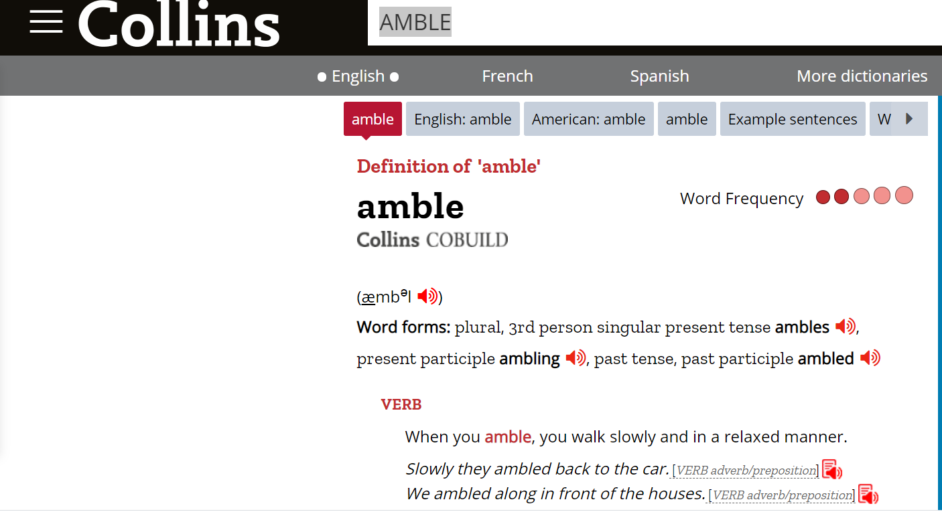
Go to collinsdictionary.com and type in the word you want to learn.
https://www.collinsdictionary.com/dictionary/english/amble
Click here to read some example sentences.
Click to hear the word. It’s very important that you learn how to say the word.

Slide 36
2 mins
CLOZE
1) Her efforts resulted in an excellent grade.
2) Following a rainy spell, the garden plants began to .
3) The judge showed him since he was truly sorry.
4) If you offend the king, he may you to another country.
5) Children do best if they grow up in a caring .
6) She decided to switch off the TV and __________ herself in a book.
7) After the fire, the smell of smoke seemed to for a long time .
Choose from: painstaking environment clemency flourish banish linger immerse

Slide 37
ANSWERS
CLOZE
1) Her PAINSTAKING efforts resulted in an excellent grade.
2) Following a rainy spell, the garden plants began to FLOURISH.
3) The judge showed him CLEMENCY since he was truly sorry.
4) If you offend the king, he may BANISH you to another country.
5) Children do best if they grow up in a caring ENVIRONMENT.
6) She decided to switch off the TV and IMMERSE herself in a book.
7) After the fire, the smell of smoke seemed to LINGER for a long time .
Choose from: painstaking environment clemency flourish banish linger immerse

Slide 38
2 mins
CLOZE
1) You can hedgehogs out of their hidey holes with biscuits and cups of tea.
2) I have managed to some sturdy wellingtons for my holiday in Scotland.
3) Football stickers are ; you should spend your pocket money on something more worthwhile.
4) The ___________ boy was swiftly sent to the headteacher’s office.
5) An apple and a sandwich were for my lunch.
6) William the Conqueror decided to onto English soil.
7) It’s surprising how quickly you can yourself to hot weather.
Choose from: impudent coax sufficient procure
advance frivolous accustom

Slide 39
ANSWERS
CLOZE
1) You can COAX hedgehogs out of their hidey holes with biscuits and cups of tea.
2) I have managed to PROCURE some sturdy wellingtons for my holiday in Scotland.
3) Football stickers are FRIVOLOUS; you should spend your pocket money on something more worthwhile.
4) The IMPUDENT boy was swiftly sent to the headteacher’s office.
5) An apple and a sandwich were SUFFICIENT for my lunch.
6) William the Conqueror decided to ADVANCE onto English soil.
7) It’s surprising how quickly you can ACCUSTOM yourself to hot weather.
Choose from: impudent coax sufficient accustom procure
advance frivolous

Slide 40
HYBRIDS – Which two words have I spliced together?
2 mins
accustom
erse
claim
1
6
clem
accu
proclaim
2
ger
7
ish
pompous
pom
pro
immerse
3
stom
8
cure
frivo
lin
linger
procure
pous
4
ency
9
pro
imm
clemency
flourish
5
ency
flour
frivolous

Slide 41
HYBRIDS – Which two words have I spliced together?
2 mins
accustom
ency
stom
1
6
clem
accu
proclaim
2
pous
7
cure
pompous
pom
pro
immerse
3
lous
8
ger
frivo
lin
linger
procure
erse
4
claim
9
pro
imm
clemency
flourish
5
ish
flour
frivolous

Slide 42
Add the Vowels
3 mins
get used to (something)
impossible to eat
--cc--st--m
--n--d--bl--
declare
enough
pr--cl----m
s--ff--c----nt
big-headed
go forward
p--mp----s
--dv--nc--
Become completely involved in or place under water
decorate
--mm--rs--
b--d--ck
persuade
hang around
c----x
l--ng--r
send away
get
pr--c--r--
b--n--sh
mercy or leniency
surroundings
cl--m--ncy
--nv--r--nm--nt
to grow well
rude
fl----r--sh
--mp--d--nt
not useful; a waste of time or money
very careful
fr--v--l----s
p----nst--k--ng

Slide 43
Add the Vowels
ANSWERS
get used to (something)
impossible to eat
accustom
inedible
declare
enough
proclaim
sufficient
big-headed
go forward
pompous
advance
Become completely involved in or place under water
decorate
immerse
bedeck
persuade
hang around
coax
linger
send away
get
procure
banish
mercy or leniency
surroundings
clemency
environment
to grow well
rude
flourish
impudent
not useful; a waste of time or money
very careful
frivolous
painstaking

