Slide 1
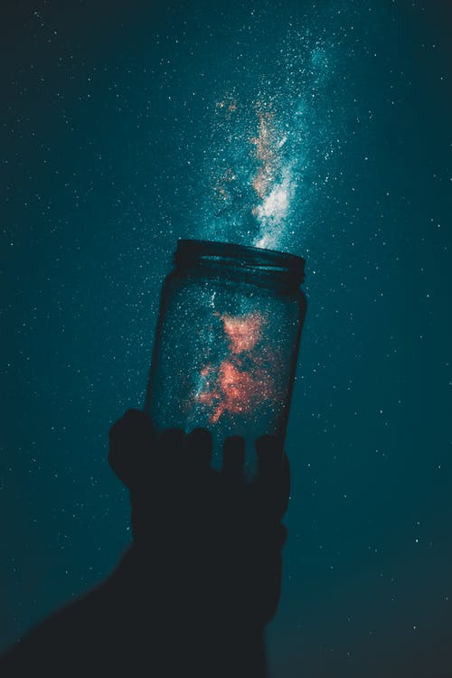
Welcome
to
Better
Tuition

Slide 2
How many
words that begin with –tion
can you write?
Send your answers in chat.

Slide 3
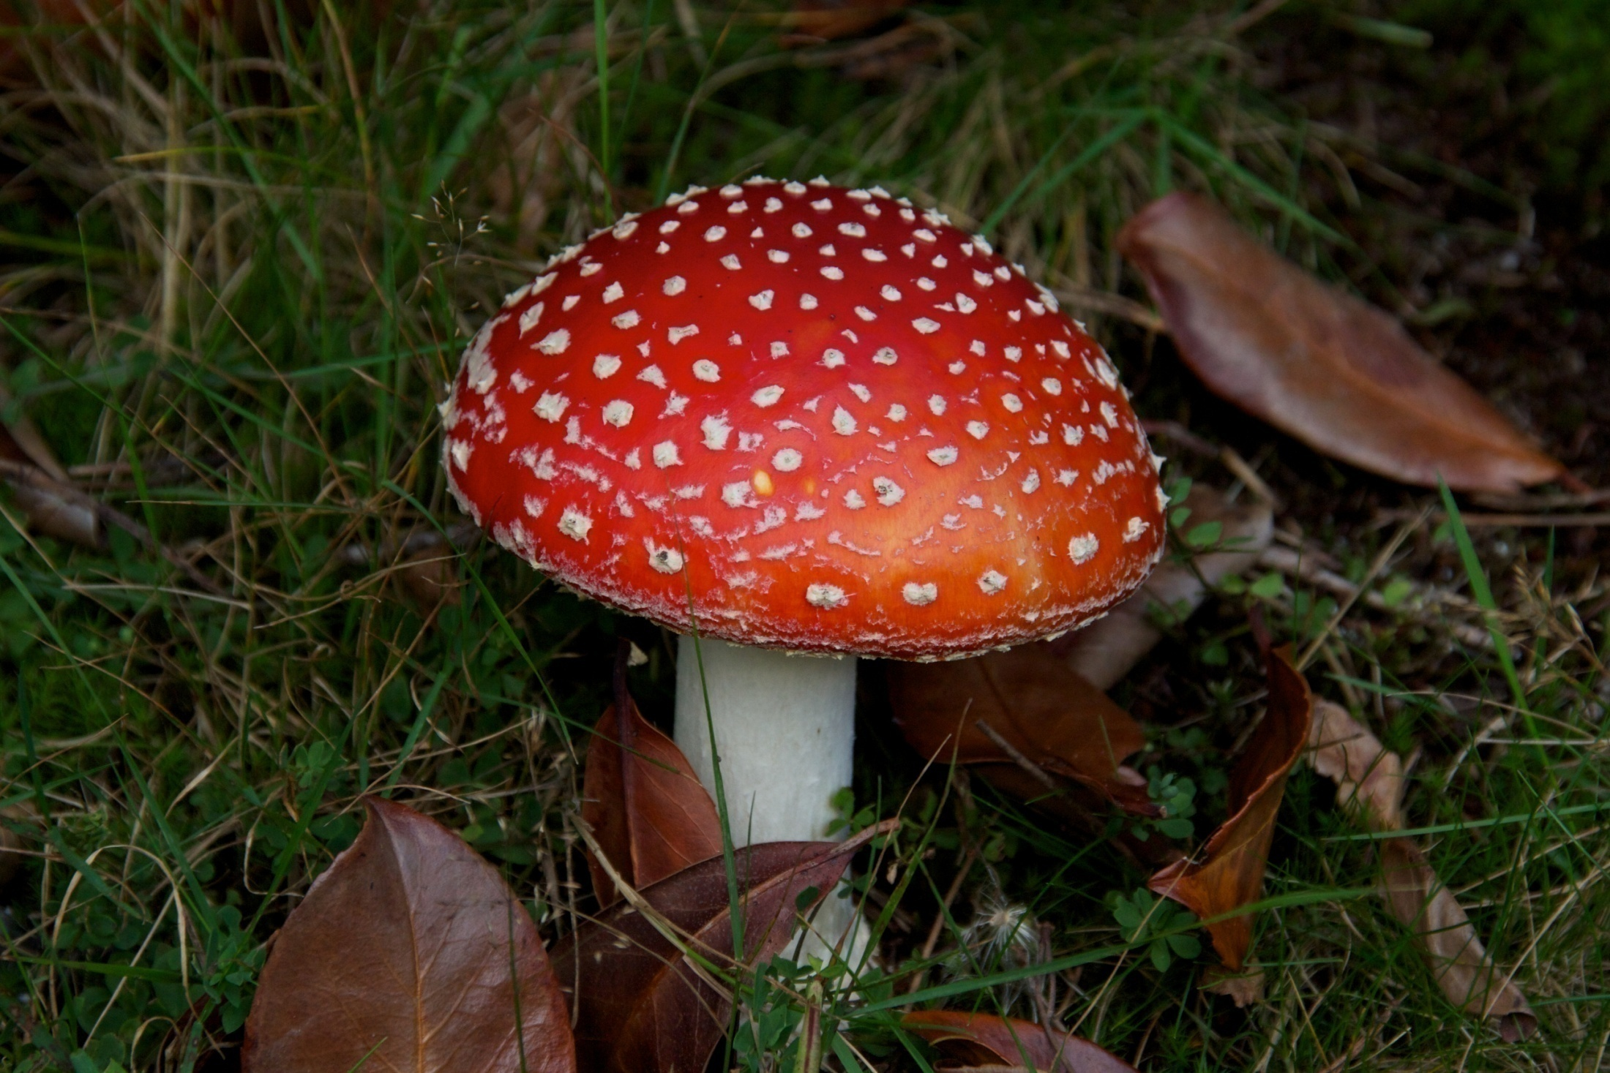
CATEGORY OF THE WEEK
2-minute challenge
1) What do all these words have in common?
carpenter n optician n plumber n horticulturalist n accountant n newsagent n radiographer n barista n
Send your answers in chat.
2) How many items can you add to this category?

Slide 4
Reverse Cloze
Write: Reverse Cloze 1) 2)
3)
4)
5)
6)
The propagation of strawberries is a delicate business. Inclement weather or unsuitable soil can cause these temperamental berries to wither before they are properly established. If you are a keen horticulturalist, you will already have a range of strategies for ensuring ‘strawberry success’. You will no doubt plant your young strawberry plants in good quality substrate and ensure that they are frequently watered during dry spells.
Cover up the bottom of the screen if you don’t want help.
Choose from: gardener die soil grown poor growing

Slide 5
Reverse Cloze
ANSWERS
The propagation/ GROWING of strawberries is a delicate business. Inclement/ POOR weather or unsuitable soil can cause these temperamental berries to wilt before they are properly established/GROWN. If you are a keen horticulturalist/GARDENER, you will already have a range of strategies for ensuring ‘strawberry success’. You will no doubt plant your young strawberry plants in good quality substrate/SOIL and ensure that they are frequently watered during dry spells.

Slide 6
2-FOR-1 Words
EACH OF THESE WORDS HAS TWO MEANINGS
READ AND MEMORISE
WORD | MEANING (NOUN) | MEANING (VERB)
Box | A carton | Hit or punch
Caution | Carefulness | warn
Convict | Criminal | Find guilty in court
Disorder | Illness or condition | Mess something up
Dwelling | A place to live | Living
Harbour | Where boats are tied up | Protect or hide
Incline | Hill or slope | Lean
Object | Thing | Protest
Permit | Licence | Allow
Pioneer | Someone who is first to do something | Be first to do something

Slide 7
2-FOR-1 Words
Use one word for two gaps
Write: 2-For-1 Gapfill 1) 2)
3)
4)
5)
6)
7)
8)
9)
10)
1a) The police officer was sure they had been ing criminals. b) Our boat was safely anchored in St Ives .
2a) One morning, a strange was left on my doorstep. b) She s very strongly to people throwing litter on the ground.
3a) The scientist Marie Curie was a of radiation therapy. b) Alexander Graham Bell ed the use of the telephone.
4a) The cottage on the edge of the village was a very simple . b) Those in the north of England benefit from frequent rain showers.
5a) The two friends began to playfully. b) With some trepidation, he opened the sturdy .
2.5 mins
CHOOSE FROM: object pioneer dwelling box harbour

Slide 8
2-FOR-1 Words
Use one word for two gaps
6a) The judge decided to her of burglary. b) He couldn’t find a job because he was a .
7a) Her teacher would not her to eat sweets in class. b) If you want to climb Everest, you have to get a special .
8a) My aunt suffers from a which means she cannot go out in the sun. b) I asked him not to my desk but when I returned it was very messy..
9a) Any sensible adult will you to cross the road carefully. b) The police gave him a after he drove his car too fast.
10a) The school was at the top of an and we arrived out of breath. b) She was d over her book, engrossed in the story.
2.5 mins
CHOOSE FROM: incline disorder permit convict caution

Slide 9
2-FOR-1 Words
Use one word for two gaps
1a) The police officer was sure they had been HARBOURing criminals. b) Our boat was safely anchored in St Ives HARBOUR.
2a) One morning, a strange OBJECT was left on my doorstep. b) She OBJECT s very strongly to people throwing litter on the ground.
3a) The scientist Marie Curie was a PIONEER of radiation therapy. b) Alexander Graham Bell PIONEERed the use of the telephone.
4a) The cottage on the edge of the village was a very simple DWELLING. b) Those DWELLING in the north of England benefit from frequent rain showers.
5a) The two friends began to BOX playfully. b) With some trepidation, he opened the sturdy BOX.
LET’S CHECK OUR ANSWERS

Slide 10
2-FOR-1 Words
Use one word for two gaps
6a) The judge decided to CONVICT her of burglary. b) He couldn’t find a job because he was a CONVICT.
7a) Her teacher would not PERMIT her to eat sweets in class. b) If you want to climb Everest, you have to get a special PERMIT.
8a) My aunt suffers from a DISORDER which means she cannot go out in the sun. b) I asked him not to DISORDER my desk but when I returned it was very messy..
9a) Any sensible adult will CAUTION you to cross the road carefully. b) The police gave him a CAUTION after he drove his car too fast.
10a) The school was at the top of an INCLINE and we arrived out of breath. b) She was INCLINE d over her book, engrossed in the story.
LET’S CHECK OUR ANSWERS

Slide 11
SYNONYMS & ANTONYMS
APPROVE
Box
Caution
Convict
Disorder
Dwelling
Harbour
Incline
Object
Permit
Pioneer
Write: Synonyms & Antonyms 1) 2)
3)
4)
5)
6)
7)
8)
9)
10)
RECEPTACLE
ASCENT
RECKLESSNESS
RESIDENCE
EXPEL
TRAILBLAZER
ARRANGE
LAWBREAKER
FORBID

Slide 12
SYNONYMS & ANTONYMS
APPROVE
RECEPTACLE
SYNONYM
Box
Caution
Convict
Disorder
Dwelling
Harbour
Incline
Object
Permit
Pioneer
ASCENT
RECKLESSNESS
RESIDENCE
EXPEL
TRAILBLAZER
ARRANGE
LAWBREAKER
FORBID

Slide 13
SYNONYMS & ANTONYMS
APPROVE
RECEPTACLE
SYNONYM
Box
Caution
Convict
Disorder
Dwelling
Harbour
Incline
Object
Permit
Pioneer
RECKLESSNESS
SYNONYM
ASCENT
RESIDENCE
EXPEL
TRAILBLAZER
ARRANGE
LAWBREAKER
FORBID

Slide 14
SYNONYMS & ANTONYMS
APPROVE
RECEPTACLE
SYNONYM
Box
Caution
Convict
Disorder
Dwelling
Harbour
Incline
Object
Permit
Pioneer
RECKLESSNESS
SYNONYM
LAWBREAKER
SYNONYM
ASCENT
RESIDENCE
EXPEL
TRAILBLAZER
ARRANGE
FORBID

Slide 15
SYNONYMS & ANTONYMS
APPROVE
RECEPTACLE
SYNONYM
Box
Caution
Convict
Disorder
Dwelling
Harbour
Incline
Object
Permit
Pioneer
RECKLESSNESS
SYNONYM
LAWBREAKER
SYNONYM
ASCENT
ARRANGE
ANTONYM
RESIDENCE
EXPEL
TRAILBLAZER
FORBID

Slide 16
SYNONYMS & ANTONYMS
APPROVE
RECEPTACLE
SYNONYM
Box
Caution
Convict
Disorder
Dwelling
Harbour
Incline
Object
Permit
Pioneer
RECKLESSNESS
SYNONYM
LAWBREAKER
SYNONYM
ASCENT
ARRANGE
ANTONYM
RESIDENCE
SYNONYM
EXPEL
TRAILBLAZER
FORBID

Slide 17
SYNONYMS & ANTONYMS
APPROVE
RECEPTACLE
SYNONYM
Box
Caution
Convict
Disorder
Dwelling
Harbour
Incline
Object
Permit
Pioneer
RECKLESSNESS
SYNONYM
LAWBREAKER
SYNONYM
ASCENT
ARRANGE
ANTONYM
RESIDENCE
SYNONYM
EXPEL
ANTONYM
TRAILBLAZER
FORBID

Slide 18
SYNONYMS & ANTONYMS
APPROVE
RECEPTACLE
SYNONYM
Box
Caution
Convict
Disorder
Dwelling
Harbour
Incline
Object
Permit
Pioneer
RECKLESSNESS
SYNONYM
LAWBREAKER
SYNONYM
ARRANGE
ANTONYM
RESIDENCE
SYNONYM
EXPEL
ANTONYM
ASCENT
SYNONYM
TRAILBLAZER
FORBID

Slide 19
SYNONYMS & ANTONYMS
RECEPTACLE
SYNONYM
Box
Caution
Convict
Disorder
Dwelling
Harbour
Incline
Object
Permit
Pioneer
RECKLESSNESS
SYNONYM
LAWBREAKER
SYNONYM
ARRANGE
ANTONYM
RESIDENCE
SYNONYM
EXPEL
ANTONYM
ASCENT
SYNONYM
APPROVE
TRAILBLAZER
ANTONYM
FORBID

Slide 20
SYNONYMS & ANTONYMS
RECEPTACLE
SYNONYM
Box
Caution
Convict
Disorder
Dwelling
Harbour
Incline
Object
Permit
Pioneer
RECKLESSNESS
SYNONYM
LAWBREAKER
SYNONYM
ARRANGE
ANTONYM
RESIDENCE
SYNONYM
EXPEL
ANTONYM
ASCENT
SYNONYM
APPROVE
TRAILBLAZER
ANTONYM
FORBID
ANTONYM

Slide 21
SYNONYMS & ANTONYMS
RECEPTACLE
SYNONYM
Box
Caution
Convict
Disorder
Dwelling
Harbour
Incline
Object
Permit
Pioneer
RECKLESSNESS
SYNONYM
LAWBREAKER
SYNONYM
ARRANGE
ANTONYM
RESIDENCE
SYNONYM
EXPEL
ANTONYM
ASCENT
SYNONYM
APPROVE
ANTONYM
FORBID
ANTONYM
TRAILBLAZER
SYNONYM

Slide 22
Prefixes
UN
UNTIDY
POSSIBLE
DIS
DISAPPROVE
TRUST
MIS
MISTRUST
TIDY
IM
IMPOSSIBLE
LEGAL
IL
ILLEGAL
APPROVE

Slide 23
Prefixes
UN
UNWILLING
MORTAL
DIS
DISOWN
WILLING
MIS
MISREAD
OWN
IM
IMMORTAL
LEGIBLE
IL
ILLEGIBLE
READ

Slide 24
Words to learn for next week
3 mins
walk slowly and relaxed
celebrate
amble
jubilate
grow rapidly
capsize
burgeon
keel (over)
think about something carefully
Be forced to remain in an unpleasant situation.
contemplate
languish
flood or overwhelm
interfere
deluge
meddle
snuggle/ move into a comfortable position
come from inside something
nestle
emanate
make or create
deliberately make something confusing
forge
obfuscate
try to make someone angry
cause something to continue
goad
perpetuate
pay attention to something
make something stop
heed
quell
breathe in
go back
inhale
recede

Slide 25
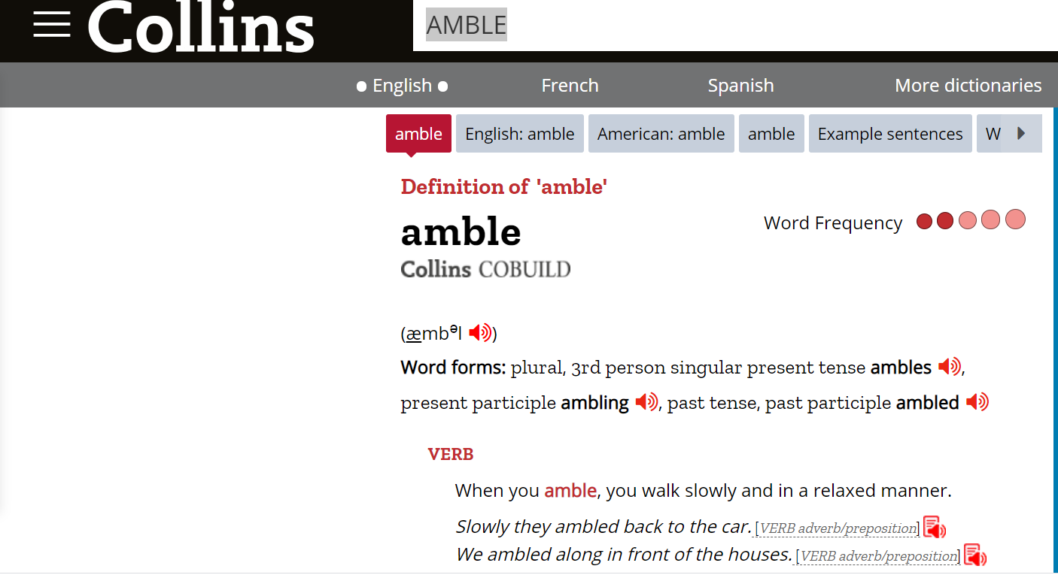
Go to collinsdictionary.com and type in the word you want to learn.
https://www.collinsdictionary.com/dictionary/english/amble
Click here to read some example sentences.
Click to hear the word. It’s very important that you learn how to say the word.

Slide 26
ANAGRAMS – unjumble the words
2 mins
Be forced to remain in an unpleasant situation.
make or create
regof
huganuli
flood or overwhelm
snuggle/ move into a comfortable position
eglude
stelen
grow rapidly
celebrate
urgebon
ubeatjil
breathe in
make something stop
leanhi
elluq

Slide 27
ANAGRAMS – unjumble the words
2 mins
Be forced to remain in an unpleasant situation.
make or create
regof
huganuli
flood or overwhelm
snuggle/ move into a comfortable position
eglude
stelen
grow rapidly
celebrate
urgebon
ubeatjil
breathe in
make something stop
leanhi
elluq

Slide 28
ANAGRAMS – unjumble the words
2 mins
Be forced to remain in an unpleasant situation.
make or create
regof
huganuli
flood or overwhelm
snuggle/ move into a comfortable position
eglude
nestle
grow rapidly
celebrate
urgebon
ubeatjil
breathe in
make something stop
leanhi
elluq

Slide 29
ANAGRAMS – unjumble the words
2 mins
Be forced to remain in an unpleasant situation.
make or create
regof
huganuli
flood or overwhelm
snuggle/ move into a comfortable position
eglude
nestle
grow rapidly
celebrate
urgebon
jubilate
breathe in
make something stop
leanhi
elluq

Slide 30
ANAGRAMS – unjumble the words
2 mins
Be forced to remain in an unpleasant situation.
make or create
regof
huganuli
flood or overwhelm
snuggle/ move into a comfortable position
eglude
nestle
grow rapidly
celebrate
urgebon
jubilate
breathe in
make something stop
leanhi
quell

Slide 31
ANAGRAMS – unjumble the words
2 mins
Be forced to remain in an unpleasant situation.
make or create
regof
languish
flood or overwhelm
snuggle/ move into a comfortable position
eglude
nestle
grow rapidly
celebrate
urgebon
jubilate
breathe in
make something stop
leanhi
quell

Slide 32
ANAGRAMS – unjumble the words
2 mins
Be forced to remain in an unpleasant situation.
make or create
regof
languish
flood or overwhelm
snuggle/ move into a comfortable position
deluge
nestle
grow rapidly
celebrate
urgebon
jubilate
breathe in
make something stop
leanhi
quell

Slide 33
ANAGRAMS – unjumble the words
2 mins
Be forced to remain in an unpleasant situation.
make or create
regof
languish
flood or overwhelm
snuggle/ move into a comfortable position
deluge
nestle
grow rapidly
celebrate
burgeon
jubilate
breathe in
make something stop
leanhi
quell

Slide 34
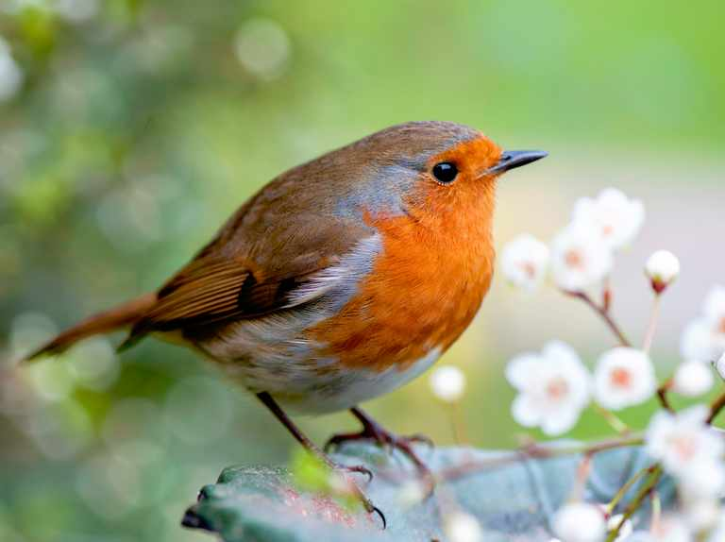
ANAGRAMS – unjumble the words
2 mins
Be forced to remain in an unpleasant situation.
make or create
forge
languish
flood or overwhelm
snuggle/ move into a comfortable position
deluge
nestle
grow rapidly
celebrate
burgeon
jubilate
breathe in
make something stop
inhale
quell

Slide 35
ADD THE VOWELS
3 mins
come from inside something
__m__n__t__
try to make someone angry
g____d
think about something carefully
c__nt__mpl__t__
deliberately make something confusing
__bf__sc__t__
interfere
m__ddl__
pay attention to something
walk slowly and relaxed
h____d
__mbl__
cause something to continue
go back
p__rp__t____t__
r__c__d__
capsize
k____l (__v__r)

Slide 36
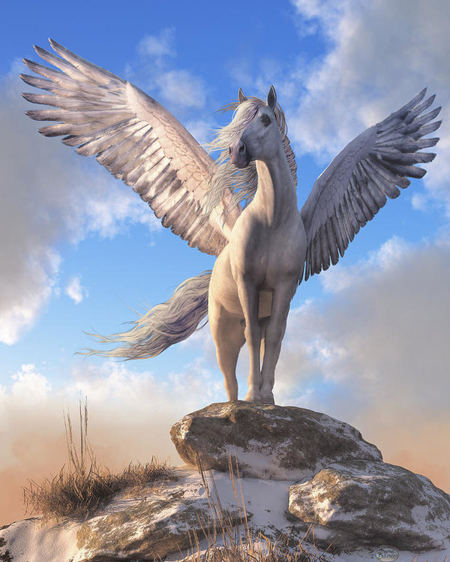
ADD THE VOWELS
ANSWERS
come from inside something
emanate
try to make someone angry
goad
think about something carefully
contemplate
deliberately make something confusing
obfuscate
interfere
meddle
pay attention to something
walk slowly and relaxed
heed
amble
cause something to continue
go back
perpetuate
recede
capsize
keel (over)

Slide 37
2 mins
CLOZE
1) It’s important to ___________ the words of your parents.
2) Toby the fast-flowing river, wondering whether to attempt to cross it.
3) A strange light seemed to ____________ from within the ruined castle.
4) Never ___________ a bull as they may attack you.
5) Reading a bedtime story will ____________ a love of books.
6) Taking deep breaths can help to __________ nerves.
Choose from: goad contemplated perpetuate emanate heed quell

Slide 38
ANSWERS
CLOZE
1) It’s important to HEED the words of your parents.
2) Toby CONTEMPLATED the fast-flowing river, wondering whether to attempt to cross it.
3) A strange light seemed to EMANATE from within the ruined castle.
4) Never GOAD a bull as they may attack you.
5) Reading a bedtime story will PERPETUATE a love of books.
6) Taking deep breaths can help to QUELL nerves.
Choose from: goad contemplated perpetuate emanate heed quell

Slide 39
2 mins
CLOZE
1) The BBC was ___________ by complaints due to the cancellation of the programme.
2) It’s important to step outside at least once a day and _________ fresh air.
3) People who ___________ are more likely to arrive late.
4) The small sapling will soon ___________ into a large tree.
5) Never overload your boat with luggage or it may ________ over.
6) The two boys soon __________ a firm friendship.
Choose from: amble keel forged deluged inhale burgeon

Slide 40
ANSWERS
CLOZE
1) The BBC was DELUGED by complaints due to the cancellation of the programme.
2) It’s important to step outside at least once a day and INHALE fresh air.
3) People who AMBLE are more likely to arrive late.
4) The small sapling will soon BURGEON into a large tree.
5) Never overload your boat with luggage or it may KEEL over.
6) The two boys soon FORGED a firm friendship.
Choose from: amble keel forged deluged inhale burgeon

